Slide 1


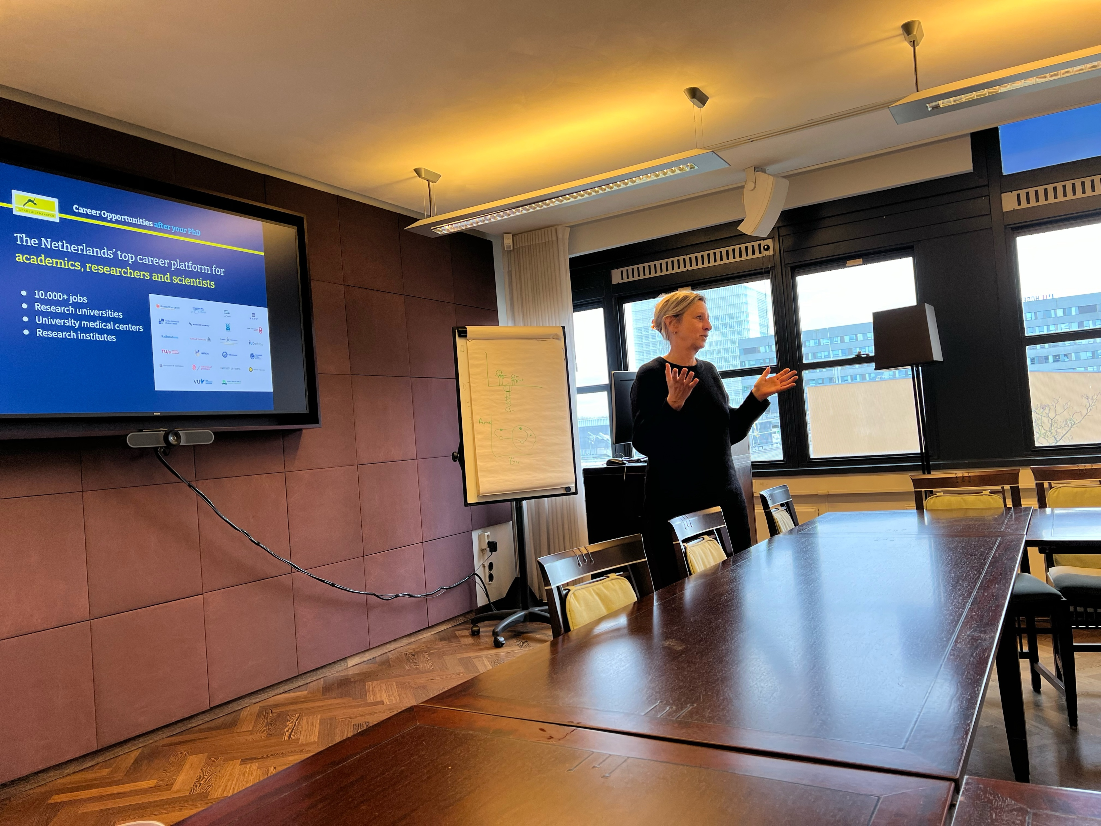

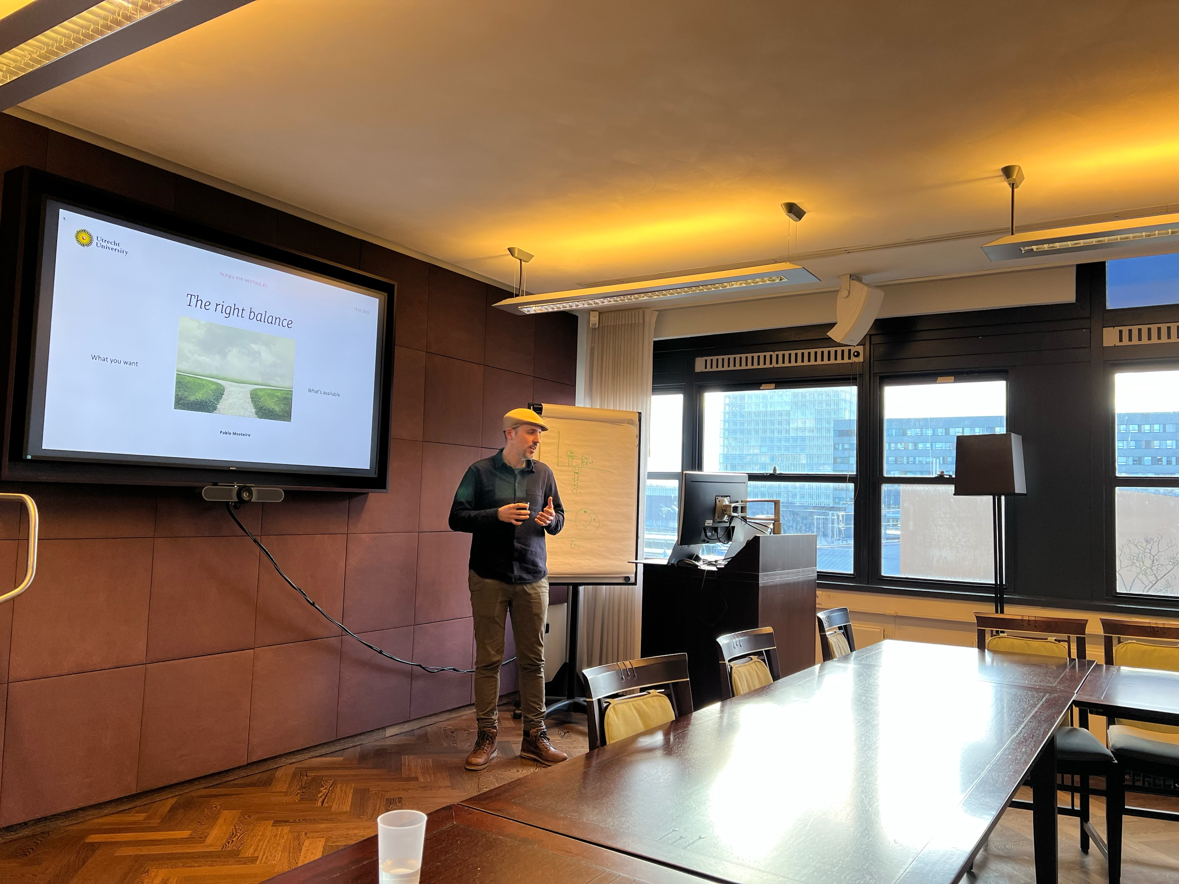
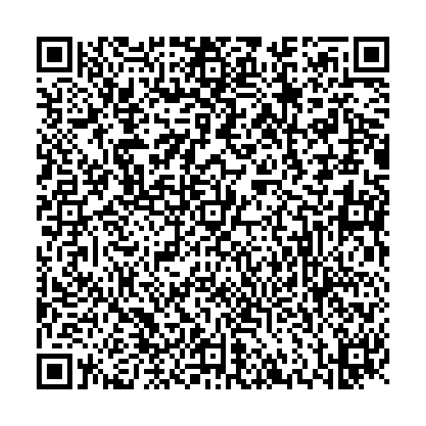
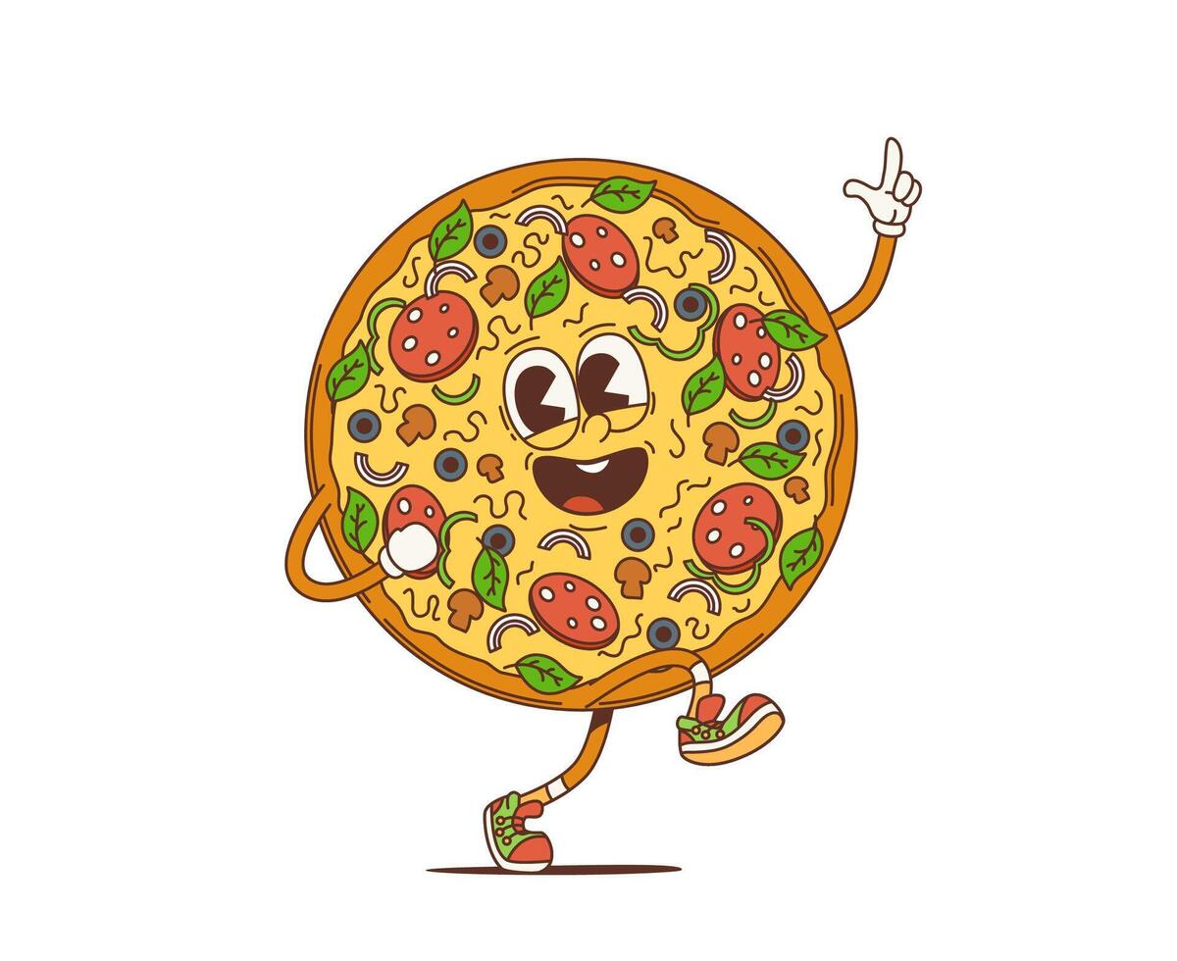
NLP@U Young Scholars Network
members
Philine Link
Yupei Du
Duygu Islakoglu
Hadi Mohammadi
Support from ADS focus area (Pablo)
Open to all young scholars!¹
New & recent events
YSN Meeting meeting #2- What to do after my PhD/PostDoc?
We had two speakers, Audrey from Academic Transfer and Pablo, who shared the different paths we can take after our PhD or postdoc, along with their personal experiences.
We aim for one representative per NLP group at UU and UMCU.
Interested? Email h.mohammadi@uu.nl.
Teams Channel
Teams Chanel

